Slide 1

Software Design and architecture (SE322) gg
Week 08
Said Nabi
said.nabi@giki.edu.pk
Faculty of Computer Science and engineering
Gik Institute Topi, Swabi

Slide 2
List of Topics
Design patterns ( Creational, Structural, Behavioral)

Slide 3
Recap:
Creational Patterns:
These patterns focus on how objects are created, ensuring flexibility and independence in object instantiation. Eg. Factory Method (creates objects without exposing creation details), Singleton (ensures one instance).
Structural Patterns:
These patterns deal with organizing classes and objects into larger structures. Eg. Adapter (converts incompatible interfaces), Composite (treats objects and groups uniformly), and Facade (simplifies subsystems).
Behavioural Patterns:
These patterns define how objects interact and communicate. Eg. Observer (notifies objects on state change), Strategy (interchangeable algorithms), and Command (encapsulates requests).

Slide 4

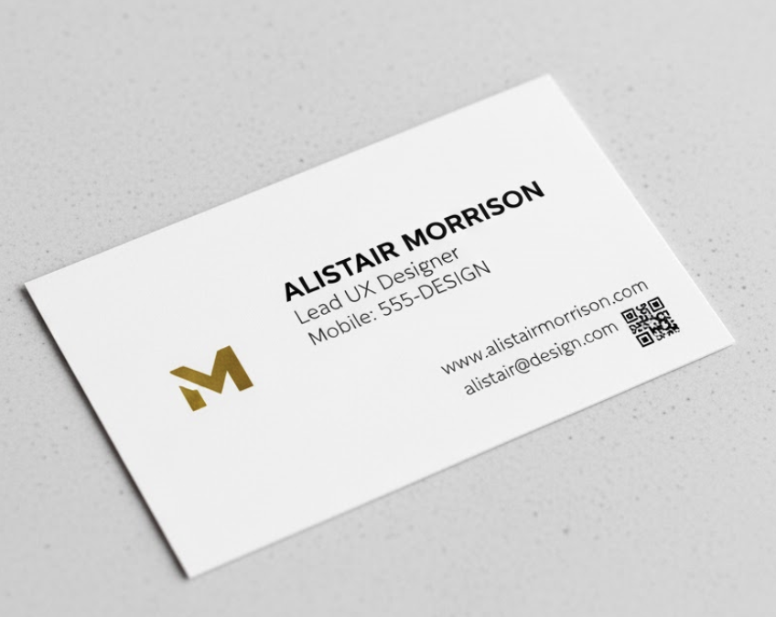

Template Design Pattern

Slide 5
Template Design Pattern Cont…
The template method pattern defines the steps of an algorithm in a general way, while deferring the implementation of some steps to subclasses, making it primarily focused on the allocation of responsibilities.
It is most effective when two or more classes have similar functionality and operations, allowing for their generalization into a new superclass, thereby enabling changes to be made in a single place, rather than in multiple locations.
The superclass contains the template method, which is inherited by subclasses, and the variations in the algorithms are handled through calls to abstract methods, the implementations of which are provided by the subclasses.

Slide 6
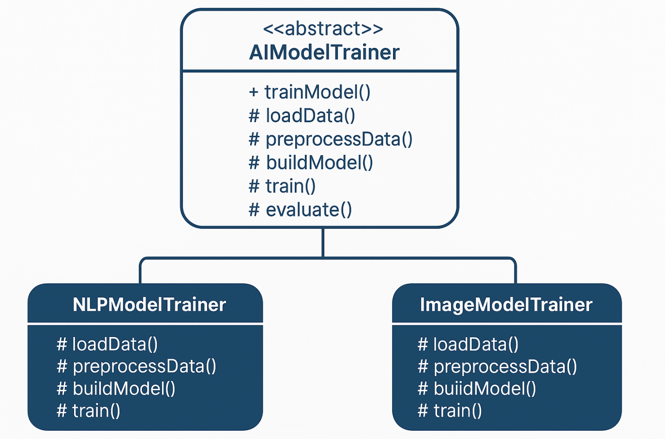
UML Diagram

Slide 7
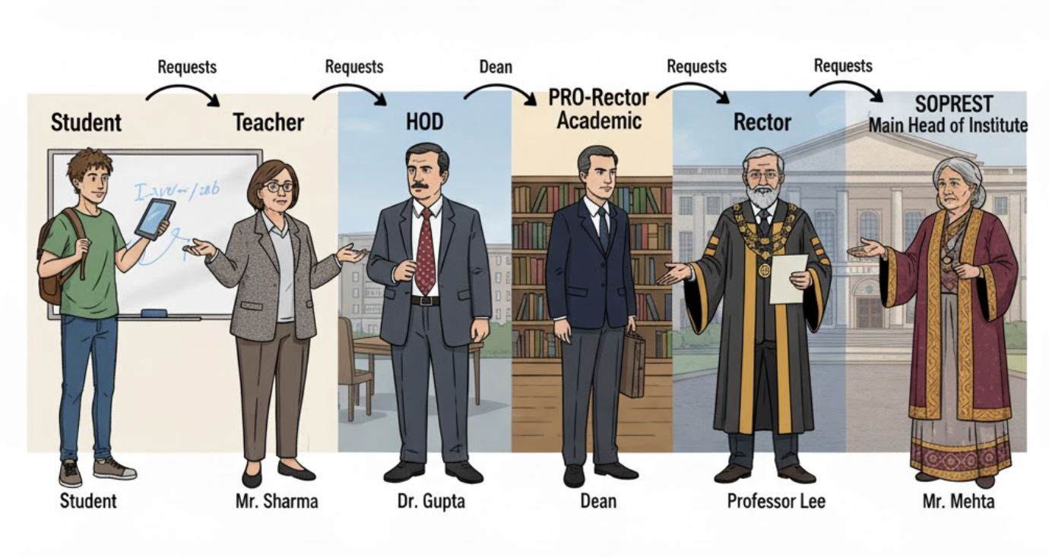
Chain of Responsibilty Design Pattern

Slide 8
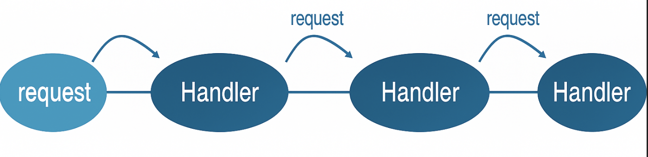
COR Pattern Cont…
The Chain of Responsibility design pattern is a behavioral pattern where a request is passed along a chain of handler objects until one of them is able to process it.
Each handler decides either to handle the request or forward it to the next handler in the chain.
This approach helps decouple the sender of a request from its receiver, allowing multiple objects to have the opportunity to handle the request without the sender knowing which one will do so.

Slide 9
COR Pattern Cont…
A real-world analogy is trying different tools to tighten a screw—you keep passing the screw (request) from one tool (handler) to another until the correct one can handle it.
In software, this pattern is commonly used for filtering or processing streams of requests, such as moving spam emails to a separate folder.
It’s also similar to exception handling in Java, where a thrown exception is passed along a series of catch blocks until one matches and handles it.

Slide 10
COR Pattern Cont…
<<interface>> Handler
- nextHandler
+ setNext(h:Handler) + handleRequest()
ManagerHandler
+ handleRequest()
DirectorHandler
+ handleRequest()
CEOHandler
+ handleRequest()

Slide 11







State Design Pattern
Object
fun3()
State 1
State 2
State 3
fun1()
fun2()
fun3()

Slide 12




Vending Machine example
Enough Coins
Insert Coin
[total==price]
Total
Idle
Display Enough
Coins
Insert Coin
Total
Total=0
[total==price]
Dispense Product
Display Total
Insert Coin
[total<price]
Insert more coins
Cancel
Total= 0;
Eject Coins

Slide 13
UML Diagram
VendingMachine
- currentState: VendingState - noCoinState: VendingState - hasCoinState: VendingState - dispenseState: VendingState - soldOutState: VendingState - itemCount: int - itemPrice: int - insertedCoins: int
+insertCoin(coin: int) +selectItem() +dispense() +returnCoin() +refill(quantity: int) +printStatus() +getXState(): VendingState +getItemCount(), ...
<<Interface>> VendingState
+insertCoin(...) +selectItem(...) +dispense(...) +returnCoin(...) +refill(...) +getStateName()
NoCoinState
Implements VS
HasCoinState
Implements VS
DispenseState
Implements VS
SoldOutState
Implements VS

Slide 14
Thank You☺

